Slide 1
Einsum and Tensordot
George Lundgren

Slide 2
Goal: To teach you what a tensor is and how to do basic
tensor operations by utilizing np.einsum() and np.tensordot()

Slide 3
Learning Targets
What is a tensor?
Einstein Summation Notation
Einsum
Tensordot
Summary
Prerequisites: Matrix Algebra
Tips:
I recommend following along with the jupyter notebook provided. I also recommend re-reading the notebook if you have trouble following this recitation
Make sure to practice with these tools to get a better understanding of them

Slide 4
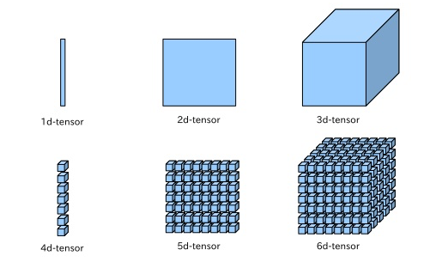
What is a Tensor?
Definition: A tensor is an n-dimensional vector used for storing data and model parameters in deep learning. Common tensor implementations are np.ndarray() and torch.tensor()

Slide 5
Common Tensor Conventions
Please read the notebook section common tensor conventions for an overview of common patterns you should look through when building your homeworks.

Slide 6
Common Tensor Conventions
Vector Data: Vectors are simply 1D tensors. Their shape is denoted as (N) where N is the number of elements present in the vector. If we want to represent a batch of vectors we get a 2D tensor with shape (B, N) where B is the batch dimension and N is the number of elements in each vector.

Slide 7
Common Tensor Conventions
Image Data: A single image is typically represented by a 3D tensor with shape (C, H, W) where C represents the number of channels, H is the height of the image in pixels, and W is the width of the image in pixels. C is used when images are RGB in which case there a typically 3 channels in an image. If C = 1, then the image is grayscale and becomes 2D. A batch of images has shape (B, C, H, W) where B is the batch dimension.

Slide 8
Common Tensor Conventions
Sequence Data: There are many types of sequence data. For example a sequence of images makes a video, a sequence of normalized real numbers makes audio, and a sequence of real numbers makes a stock signal. Sequence data is represented in 2 standard ways. Either the data is represented in a batch first or sequence first manner. Batch first representation is of shape (B, L, ...) where B is the batch dimension, L is the number of timesteps, and ... represents n-dimensinoal per time step data. Sequence first representation simply flips the batch and sequence dimension creating a shape of (L, B, ...). Seqence first storage is common in RNNs and batch first storage is common in Transformers.

Slide 9
Einstein Summation Notation
Motivation: Einstein summation notation is a shorthand mathematical convention for simplifying the notation of tensor and matrix operations. It involves omitting sum notation for matching axes. We will look at an example to get a grip on the convention.

Slide 10
Matrix Multiplication
Let us consider the definition of matrix multiplication for two real valued matrices.
We see that by omitting the summation we can imply contraction over the jth dimension of A and B creating a more concise convention for matrix multiplication.
This implication and omission of summation is precisely the definition of the einstein summation convention.

Slide 11

Dot Product
Let us now consider the einstein summation version of dot product:
We can see that this definition follows from our previous example because the sum over i is omitted in the final notation.

Slide 12
Einsum
Einsum is the standard matrix library implementation of einstein summation notation. Instead of just simply a notation, np.einsum() and similar tools provide a powerhouse for matrix operations.
Let us take a look at the documentation.

Slide 13
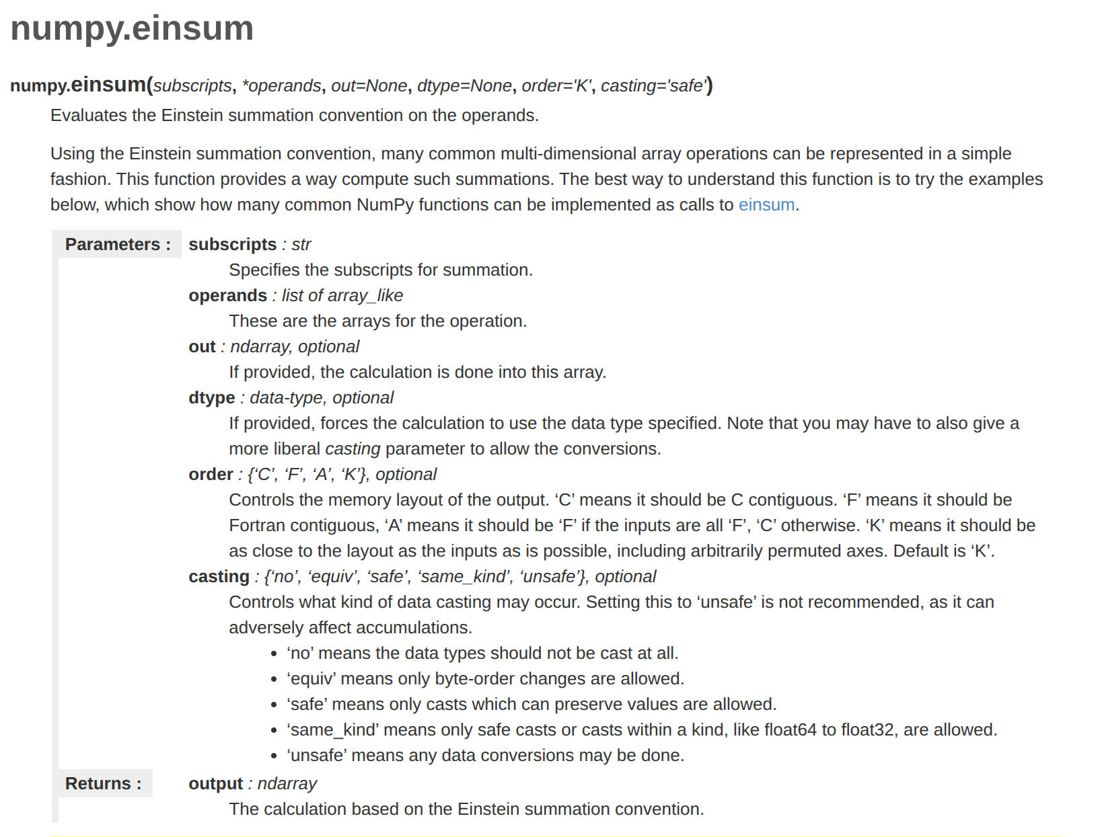

Slide 14
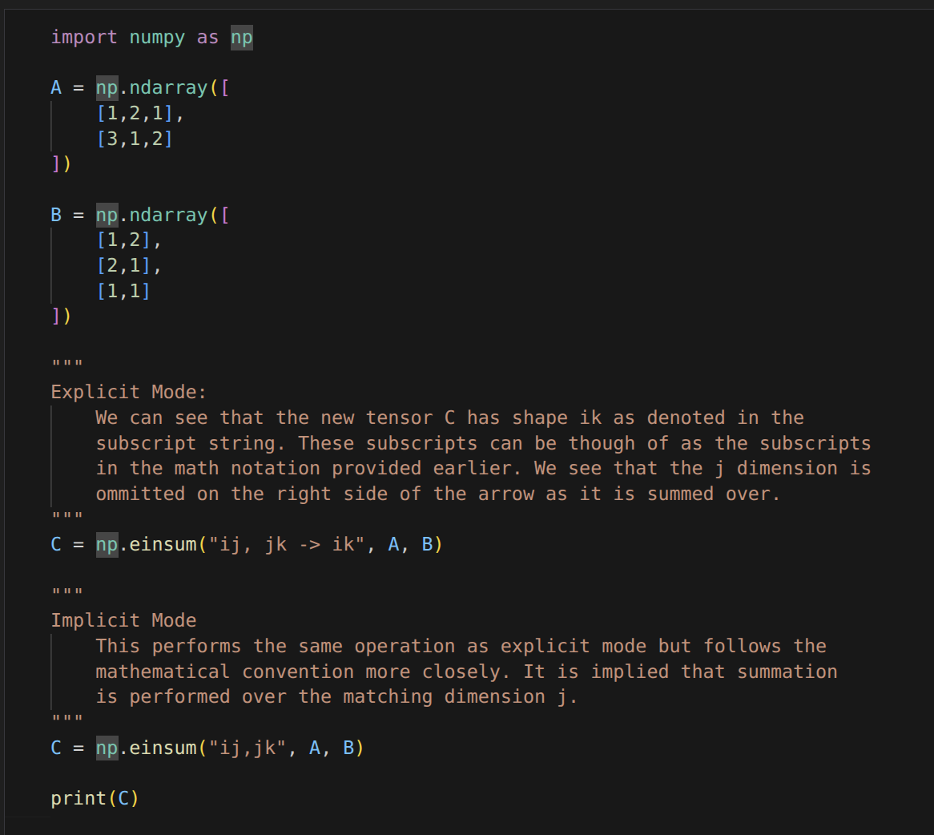
Matrix Multiplication
Notice the subscript strings used are similar to einstein summation notation
Implicit mode: is exactly einstein summation notation
Explicit mode: includes the dimensions of the output tensor and omits the contracted axes

Slide 15
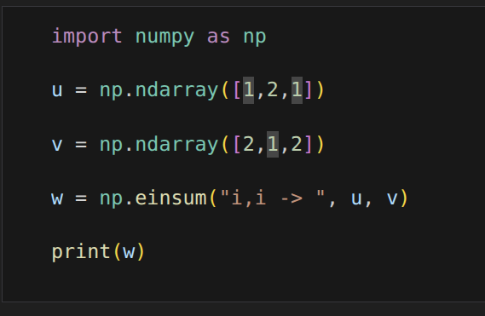
Dot Product

Slide 16
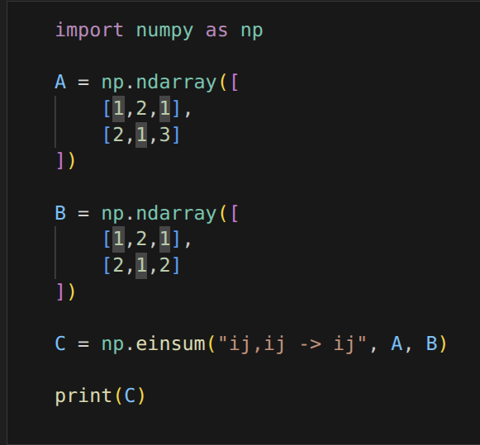
Hadamard Product (Elementwise Multiplication)

Slide 17
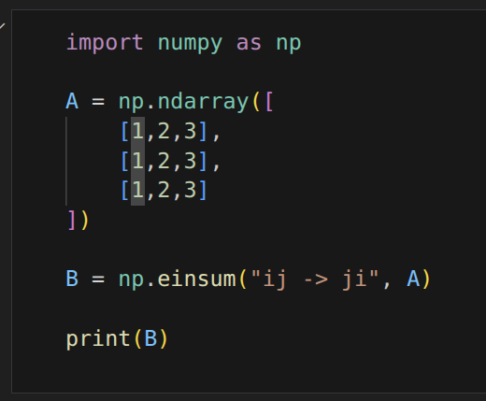
Transpose

Slide 18
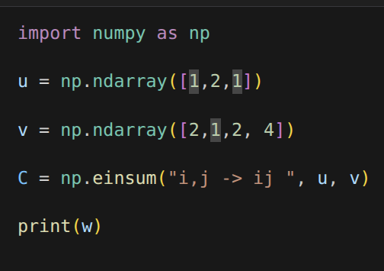
Outer Product

Slide 19
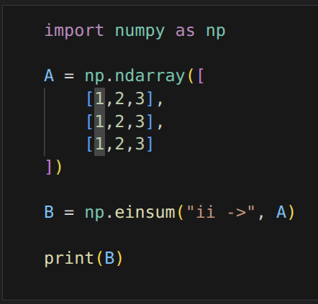
Trace

Slide 20
Tensordot
Tensordot is essentially a less flexible version of einsum that is optimized for matrix multiplication like operations. It is built specifically for elementwise multiplication and contraction.
Let us look at the documentation

Slide 21
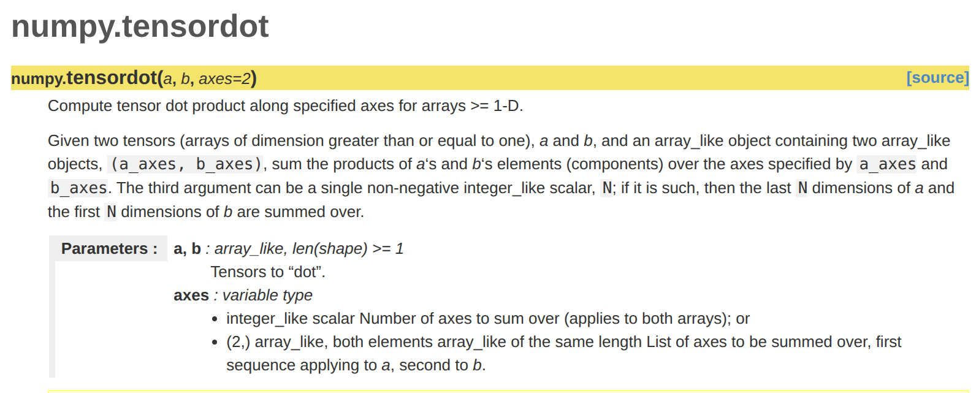

Slide 22
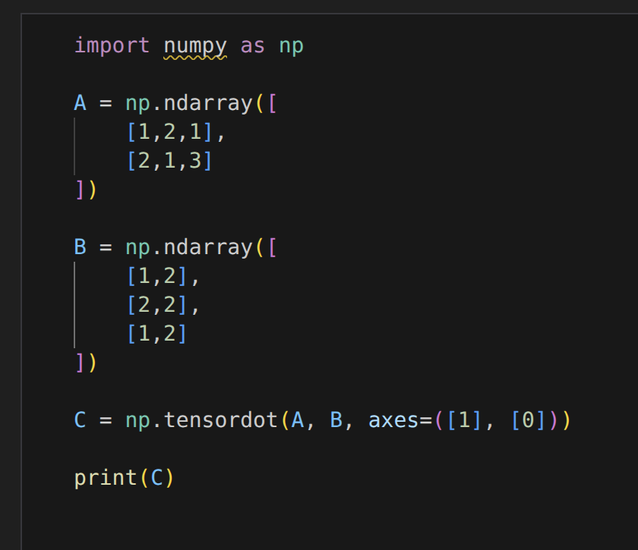
Matrix Multiplication
Notice the axes is a tuple specification of the axes for elementwise multiplication and summation (contraction)

Slide 23
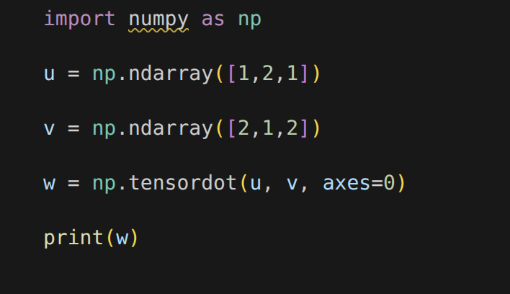
Dot Product

Slide 24
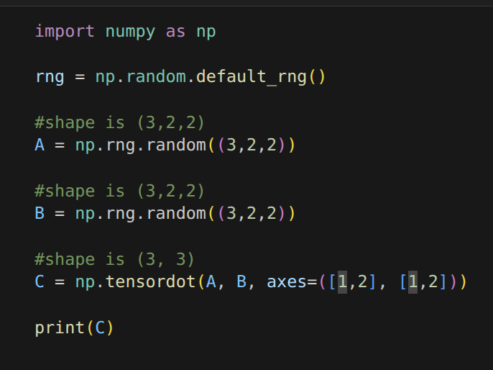
Multi Dimensional Dot Product

Slide 25
Summary
A tensor is the fundamental unit of data and parameter storage in deep learning
Einstein Summation Notation is a mathematical convention used for simplifying element wise multiplication and contraction tensor operations
Einsum is the matrix library standard for implementing einstein summation notation operations
Tensordot is a more specific version of einsum used specifically for tensor contractions
Feel free to shoot me an email with any questions or make a piazza post:
My email: glundgre@andrew.cmu.edu

